Slide 1
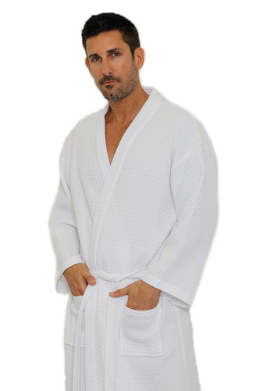
Adult Waffle Kimono Square Bathrobe
65% Natural Cotton and 35% Polyester
Lightweight
Waffle Inside & Outside
Two Patch Pockets
Double Stitched for Durability
Unisex Bathrobe
Available Colors: White
Size Width Length
S/M 52” 41”
One Size 55” 50”
XXL 58” 52”

Slide 2
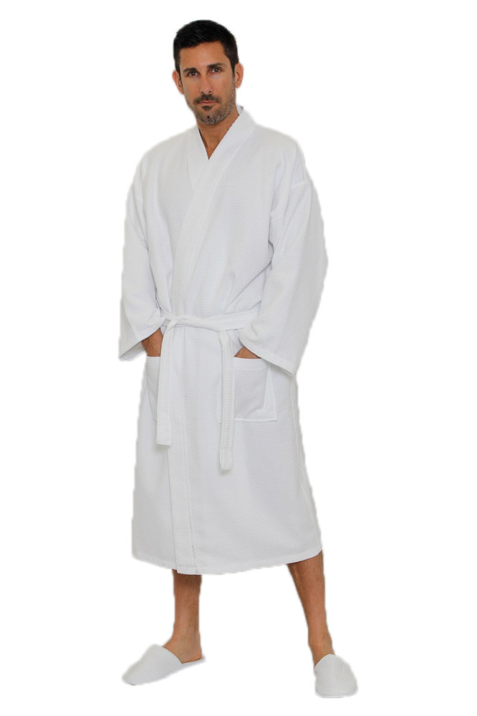
Adult Waffle Kimono Diamond Bathrobe
100% Top Quality Natural Cotton
Lightweight
Two Patch Pockets
Double Stitched For Durability
Unisex Bathrobe
Available Colors: White
Size Width Length
S/M 52” 40”
One Size 56” 50”
XXL 64” 53”

Slide 3
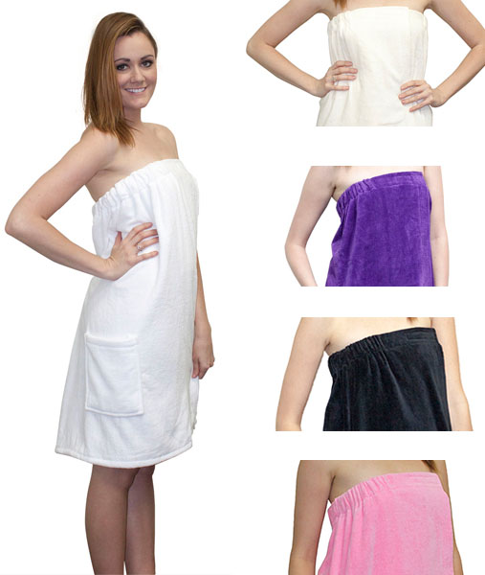
Velour Bath Wraps
Made of 100% Cotton One patch pocket
Loop Terry Cloth Inside & Smooth Velour Outside
Available Colors: White, Black, Pink, Purple, Beige
Size Length Width
One Size 30” 54”
XXL 32” 63”

Slide 4
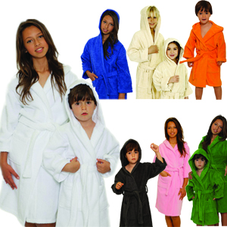
Kids Spa Robe Terry Hooded
100% Super Absorbent High Quality Natural Cotton
Hooded Unisex Bathrobe
Available Colors: White, Royal Blue, Beige, Orange, Grey, Pink, Apple Green
Size Length Waist
Small 26“ 36"
Large 36“ 42”

